Slide 1

fake news classifier
LIUYANG LI
financial accountant @ bank australia, data science enthusiast, IoD graduate

Slide 2

agenda
01
BUSINESS PROBLEM DEFINITION
a machine learning approach towards fake news detection
02
DATA PROCESS DESIGN
tackling the business problem with a data solution
VALUE DELIVERY
03
build models, evaluate performance, and repeat
NEXT STEPS AND SUMMARY
04
future improvements
Notes:
Add subheadings

Slide 3
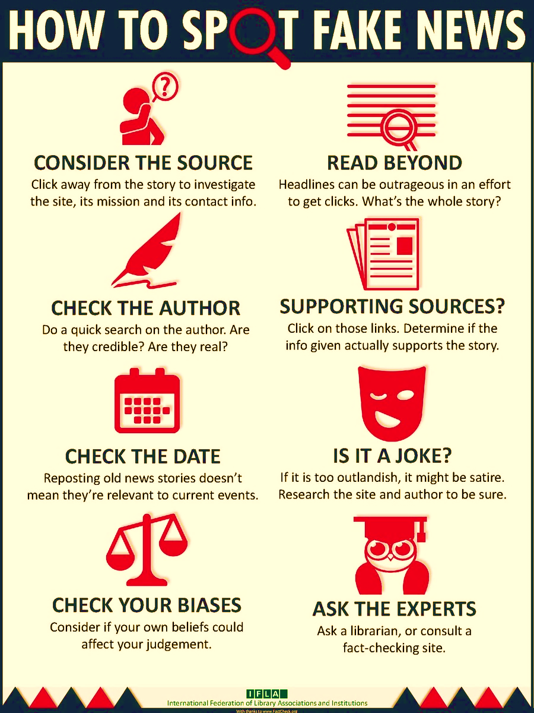
the business problem - background
According to The Guardian, half of Americans see fake news as a bigger threat than terrorism
74% of them wanting to know whether what they are reading is factual or made up
fake news has been noted to spark violence and hate crimes
WhatsApp announced that it was deleting 2 million accounts every month to prevent the spread of fake news
Notes:
Spend less time on ”spot fake news”, leads into efficiency in “business question”

Slide 4
the business question How to distinguish fake news from real news accurately and efficiently to prevent it from spreading?
the data question
Which classification model can be used to distinguish fake and real news from the subtle yet consistent differences in the language of the news articles, at what accuracy and volume?

Slide 5
data process design
TACKLING THE BUSINESS PROBLEM WITH A DATA SOLUTION

Slide 6
data process design
BUSINESS PROBLEM
WEB SCRAPING & EDA
MODELLING
- natural language processing
DATA QUESTION
FEATURE ENGINEERING – vectorisation
VALIDATION
TESTING
- fresh dataset

Slide 7
data collection
News, 24 sites
NYTimes
Fake, 26 sites
Clickhole
CNN
The Guardian, etc.
The Onion
Politifact
100percentfedup, etc.
Reuters
2075 train/test set
2433 validation set
unbalanced data: 81/19 train/test 86/14 validation
fake news
junk science
clickbait
hate group
rumour mill
conspiracy theory
extreme bias
satire

Slide 8
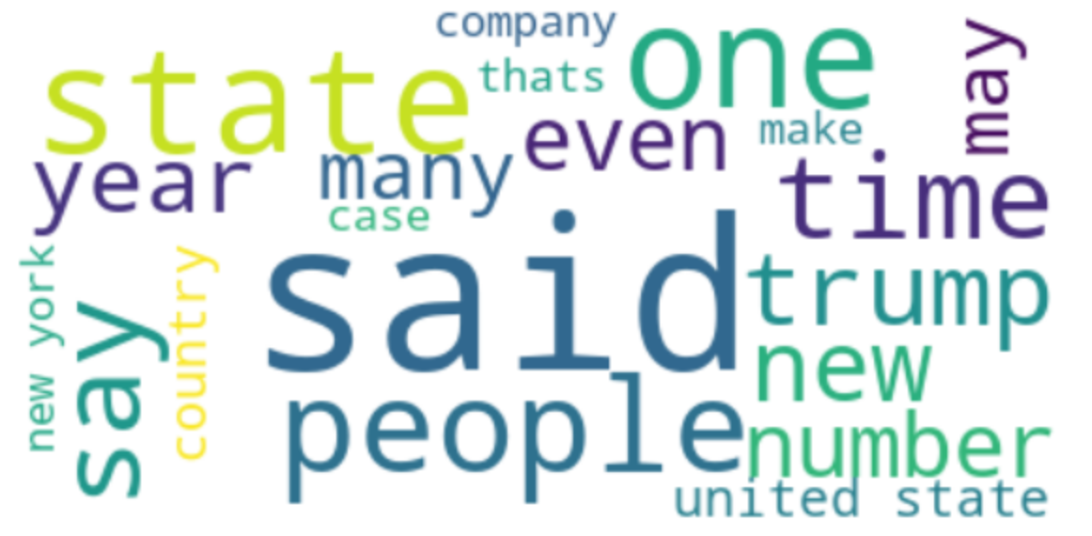
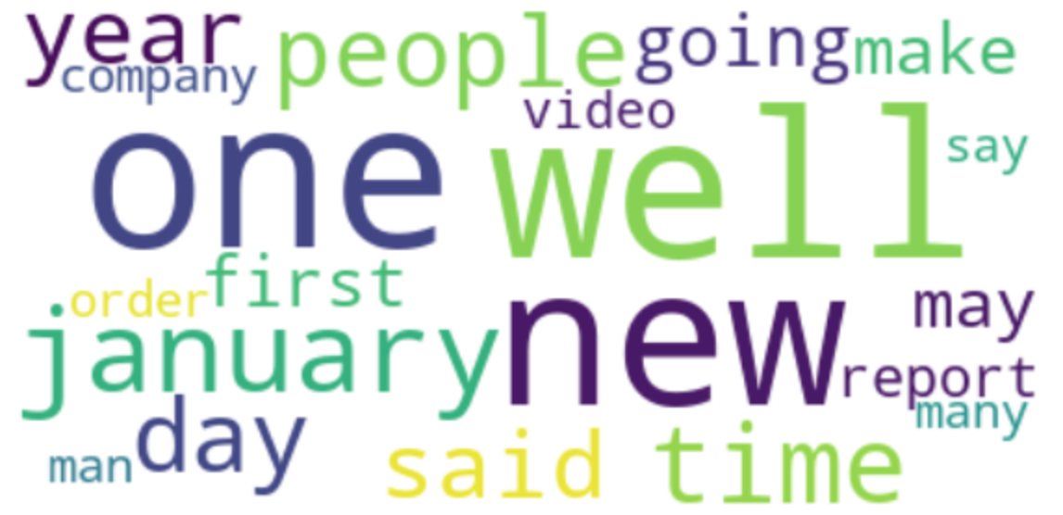
wordclouds
news
fake

Slide 9
value delivery
BUILDING DATA MODELS AND EVALUATION OF PERFORMANCE

Slide 10
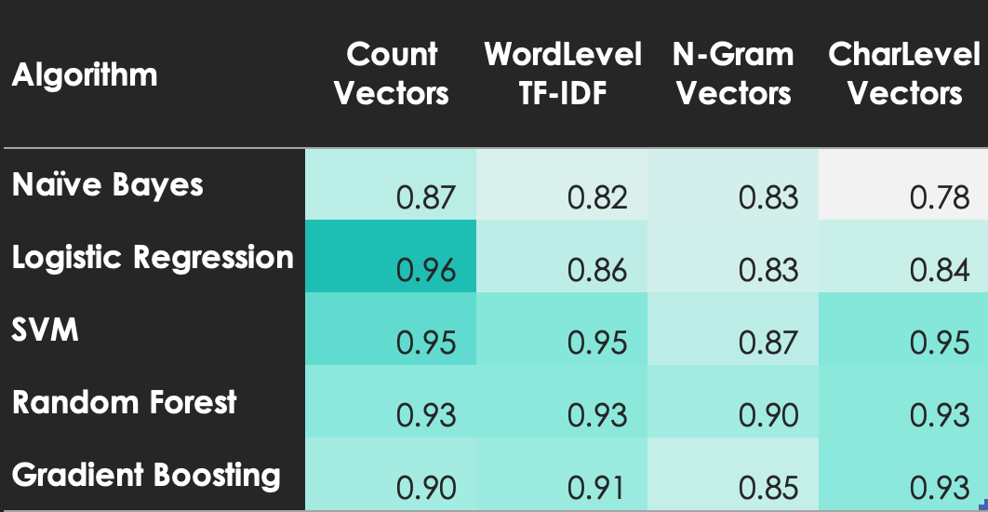
model performance
Benchmark: accuracy
Baseline: 81% (classweight)
Notes:
Change into graph/ heatmap, shorten numbers to two decimals, include Random forest in model improvement (appears less variant), elaborate on baseline, elaborate on different vectorization technics

Slide 11
top 3 performing models
IMPROVEMENTS
Hyperparameter tuning
Increasing iteration
Adding classweight
Applying imbalanced class sampling methods
SMOTE (over-sampling)
NearMiss (under-sampling)
a) + Adjusting stopwords
Removing “say”, “said”, “even” from top 20 most frequent words
 | Accuracy | Precision | Recall | ROC_AUC
SVM a) | 0.967 | 0.987 | 0.856 | 0.926
Logistic Regression – no tuning | 0.964 | 1.000 | 0.833 | 0.917
SVM c) | 0.961 | 0.987 | 0.833 | 0.915

Slide 12
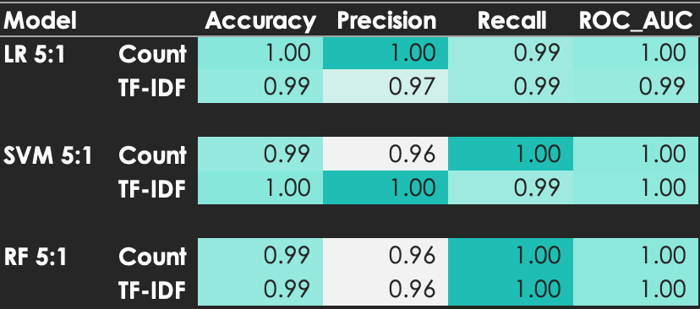
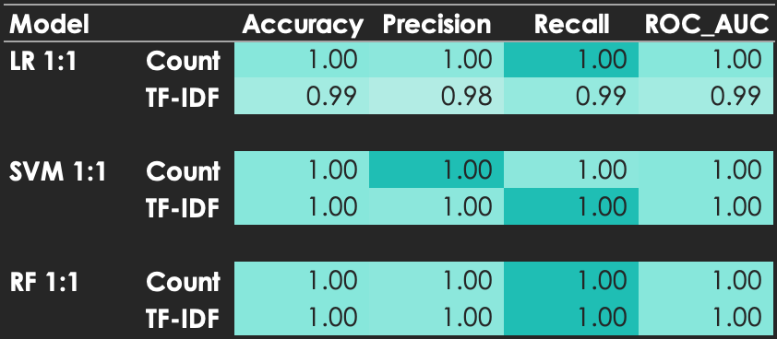
validation
new data set (2433 articles, 5:1 classweight)
random subset (600 articles, 1:1 classweight)

Slide 13
next steps
FUTURE IMPROVEMENTS

Slide 14
next steps
DATASET
optimise web scraping
API wrapper
DATA PREPROCESS
feature engineering – feature importance
DEEP LEARNING
sequence neural network
DEPLOYMENT
involvement of journalists, machine learning experts and product developers

Slide 15
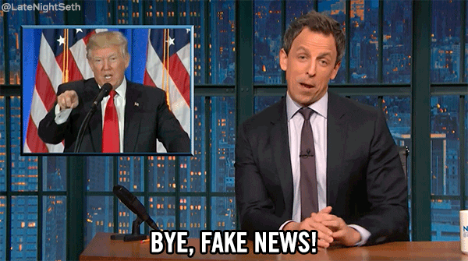
future benefits
RISK
REPUTATION
increased credibility towards customers and general public
mitigated risk of unwanted exposure and litigation
SOCIAL IMPACT
reduced polarisation of opinions through content consumption
BUSINESS
increased profit driven by heightened efficiency in fake news detection
implement technologic solutions to induce change in information consumption behaviour
empower users to make informed decisions on what to believe
improve our understanding of the world and minimise the polarisation in society

Slide 16

thank you Questions?

Slide 17
APPENDIX A – what makes up of fake news
Fake News: fabricate stories out of whole cloth with the intent of pranking the public.
Satire: provide humorous commentary on current events in the form of fake news.
Extreme Bias: traffic in political propaganda and gross distortions of fact.
Conspiracy Theory: well-known promoters of kooky conspiracy theories.
Rumor Mill: traffic in rumors, innuendo, and unverified claims.
Junk Science: promote pseudoscience, metaphysics, naturalistic fallacies, and other scientifically dubious claims.
Hate Group: promote racism, misogyny, homophobia, and other forms of discrimination.
Clickbait: aimed at generating online advertising revenue and rely on sensationalist headlines or eye-catching pictures.
SOURCE: https://addons.mozilla.org/hr/firefox/addon/bsdetector/

Slide 18
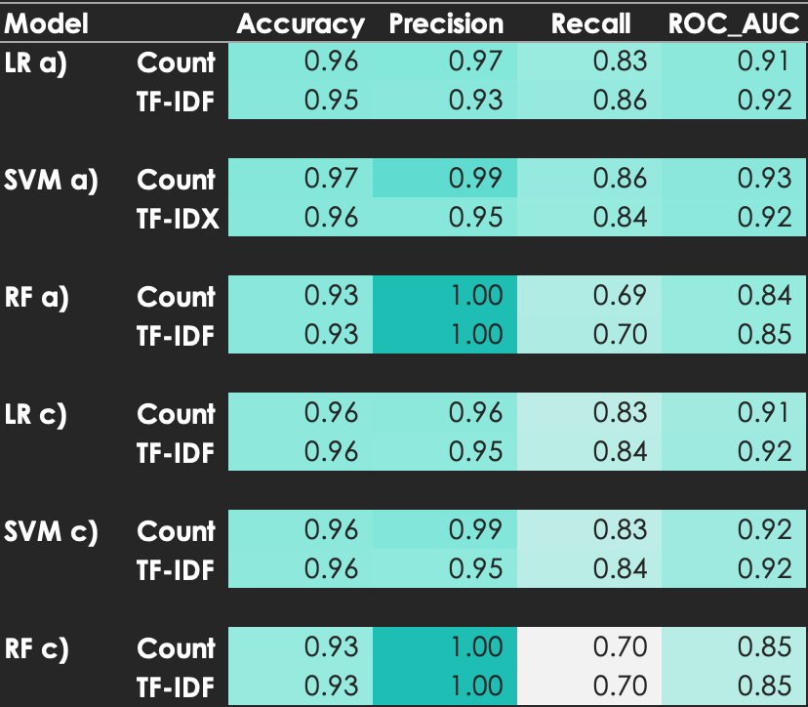
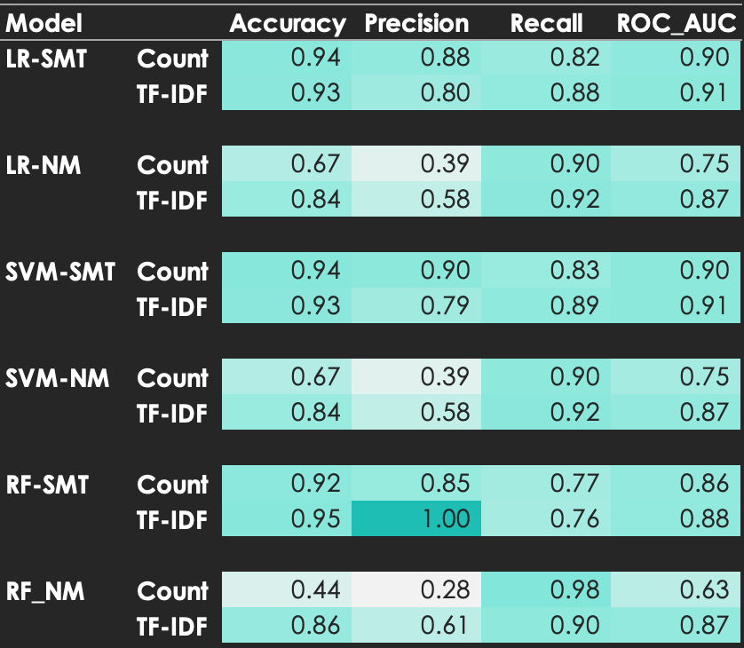
APPENDIX B – model tuning performance

